Slide 1
Prepoznavanje nonograma i njihovo rešavanje
Srđan Milaković
Soft Computing 2015
Fakultet tehničkih nauka

Slide 2
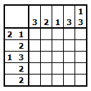
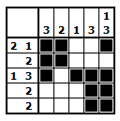
Šta je nonogram?
Nonograms, also known as Japanese crosswords, are picture logic puzzles in which cells in a grid must be colored or left blank according to numbers at the side of the grid to reveal a hidden picture.

Slide 3
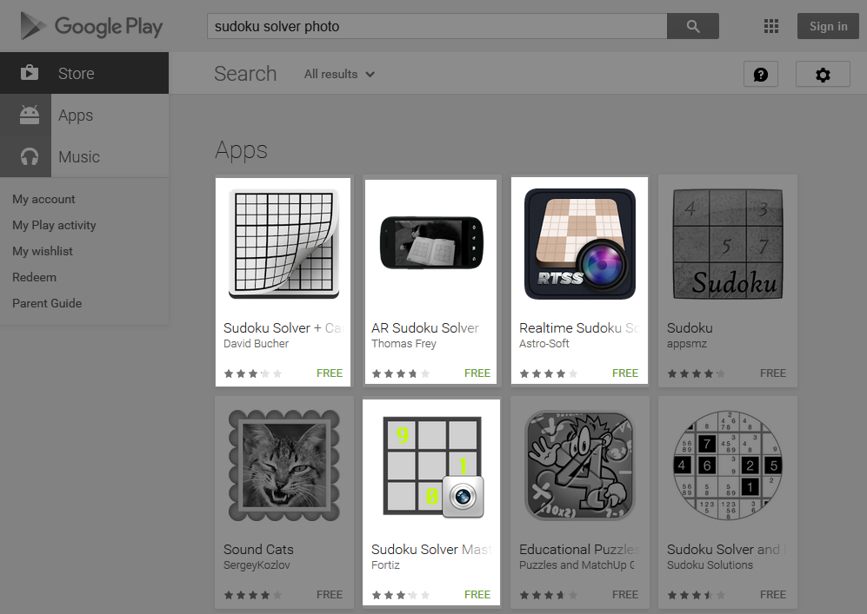
Motivacija
Bubble Cup 7 - round 1
Challenge problem - NP complete
http://www.spoj.com/problems/JCROSS/
C++ rešenje
Oko 2000 linija koda
Postoje slične aplikacije za rešavanje soudokua

Slide 4
Slična rešenja
An efficient algorithm for solving nonograms Chiung-Hsueh Yu, Hui-Lung Lee, Ling-Hwei Chen http://debut.cis.nctu.edu.tw/Publications/pdfs/J54.pdf
Object detection algorithms analysis and implementation for augmented reality system Rasa Zavistanavičiūtė, KAUNAS, 2012
Blob detection, Edge detection, Canny edge detector, Double thresholding, Sobel...
IBM - Printed Character Recognition (PCR) https://www.research.ibm.com/haifa/projects/image/ocr/pcr.html

Slide 5
Algoritam
Učitavanje slike
Detekcija cifri
Prepoznavanje cifri
Rešavanje
Prikaz rešenja
Detekcija linija
Ispravljanje perspektive
Pronalaženje nonograma

Slide 6
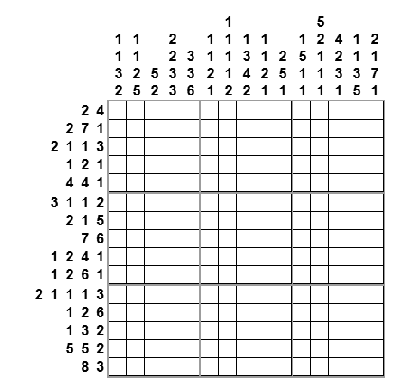
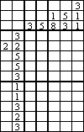
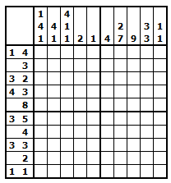
Pronalaženje nonograma
Binarizacija slike
Threshold
Canny edge detector
Image derivate
Random sample consensus (RANSAC)
Ramer–Douglas–Peucker algorithm

Slide 7
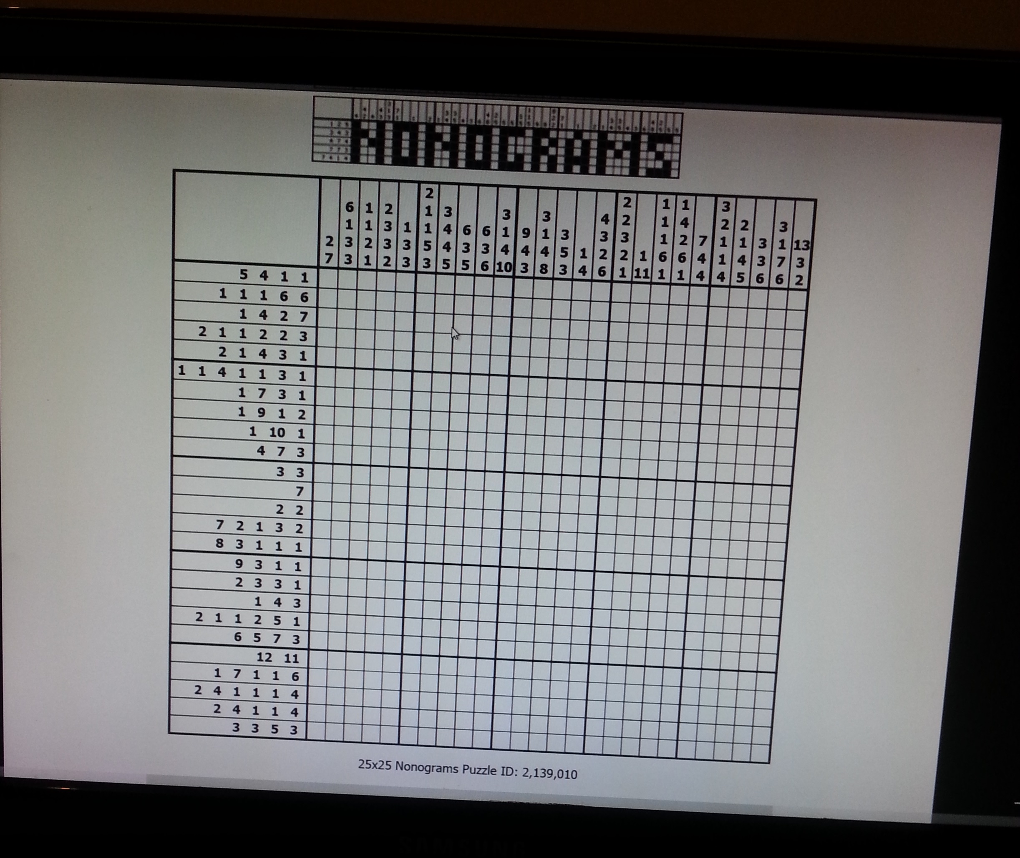
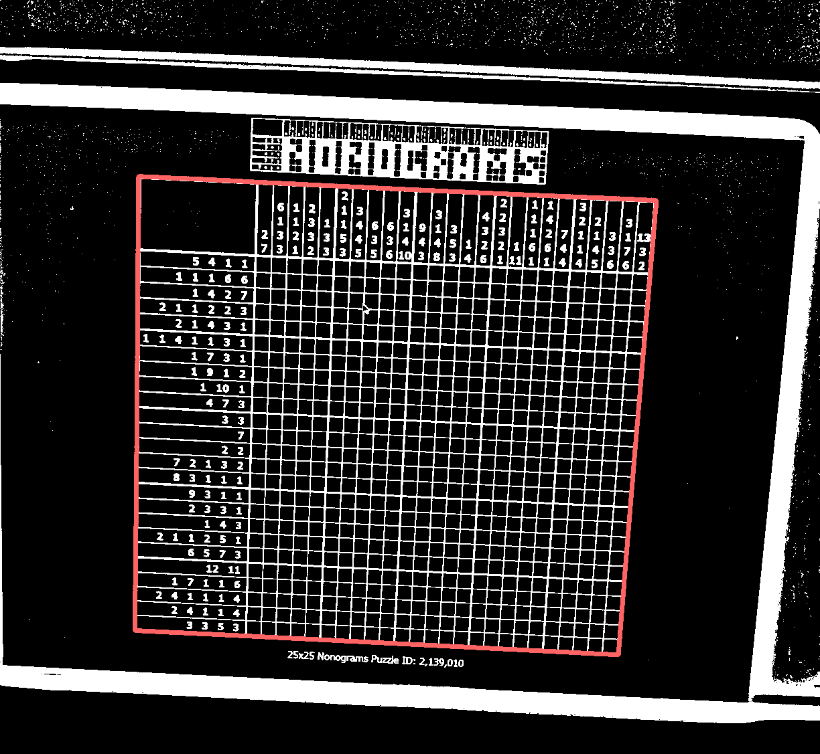
Pronalaženje nonograma
Originalna slika
Adaptive threshold + selection

Slide 8
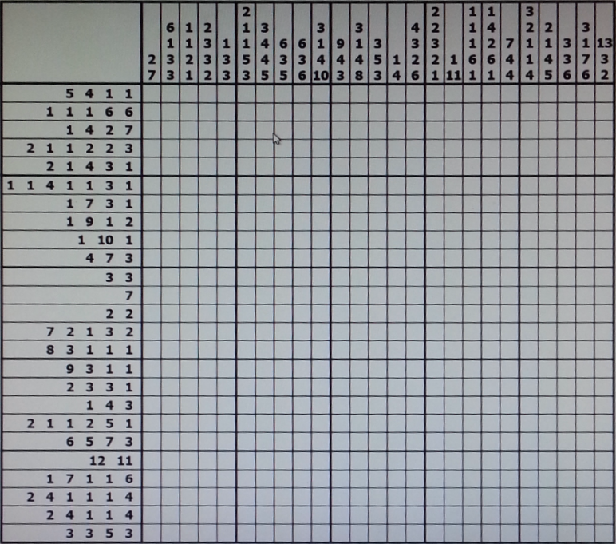
Ispravljanje perspektive

Slide 9
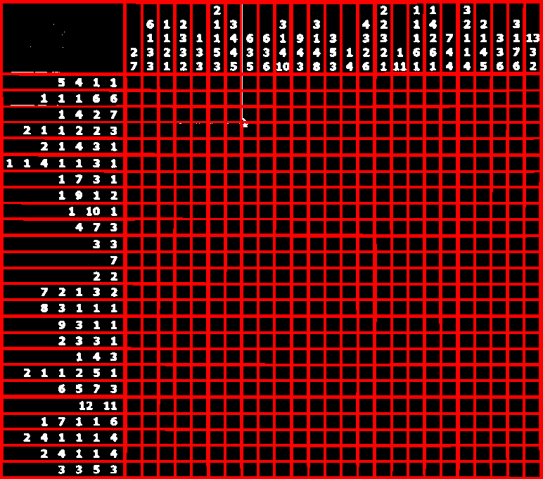
Detekcija linija
Standardna rešenja
Hough Line Transform
Probabilistic Hough Line Transform
Kerneli n x m, n >> m ili m >> n
Blur
Fixed Threshold

Slide 10

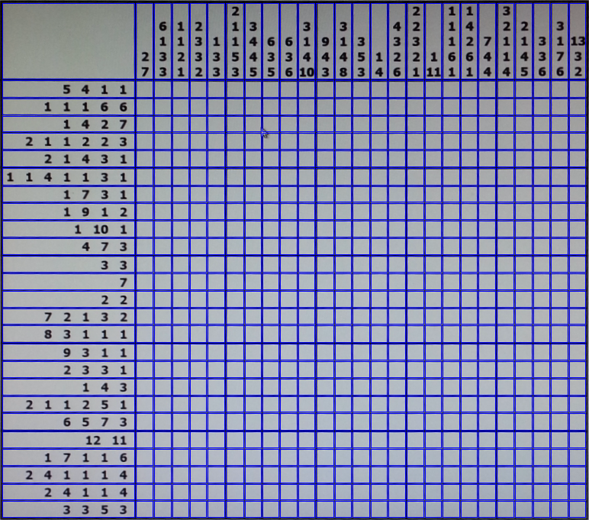
Detekcija linija
Kerneli n x m
Pravougaonici

Slide 11
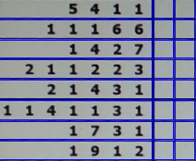
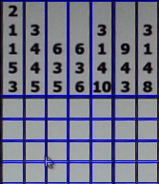
Detekcija cifri
Dve cifre ili dva broja?
k-means
DBSCAN
Dilate + contours

Slide 12

Prepoznavanje cifri
Printed Character Recognition (PCR)
Character masks
Data set
Mala greška
Jedan font

Slide 13










Maske

Slide 14
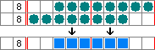
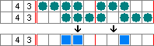
Rešavanje
Algoritmi
Simple boxing
Genetski algoritmi
Depth first search
Logička pravila
Cython

Slide 15
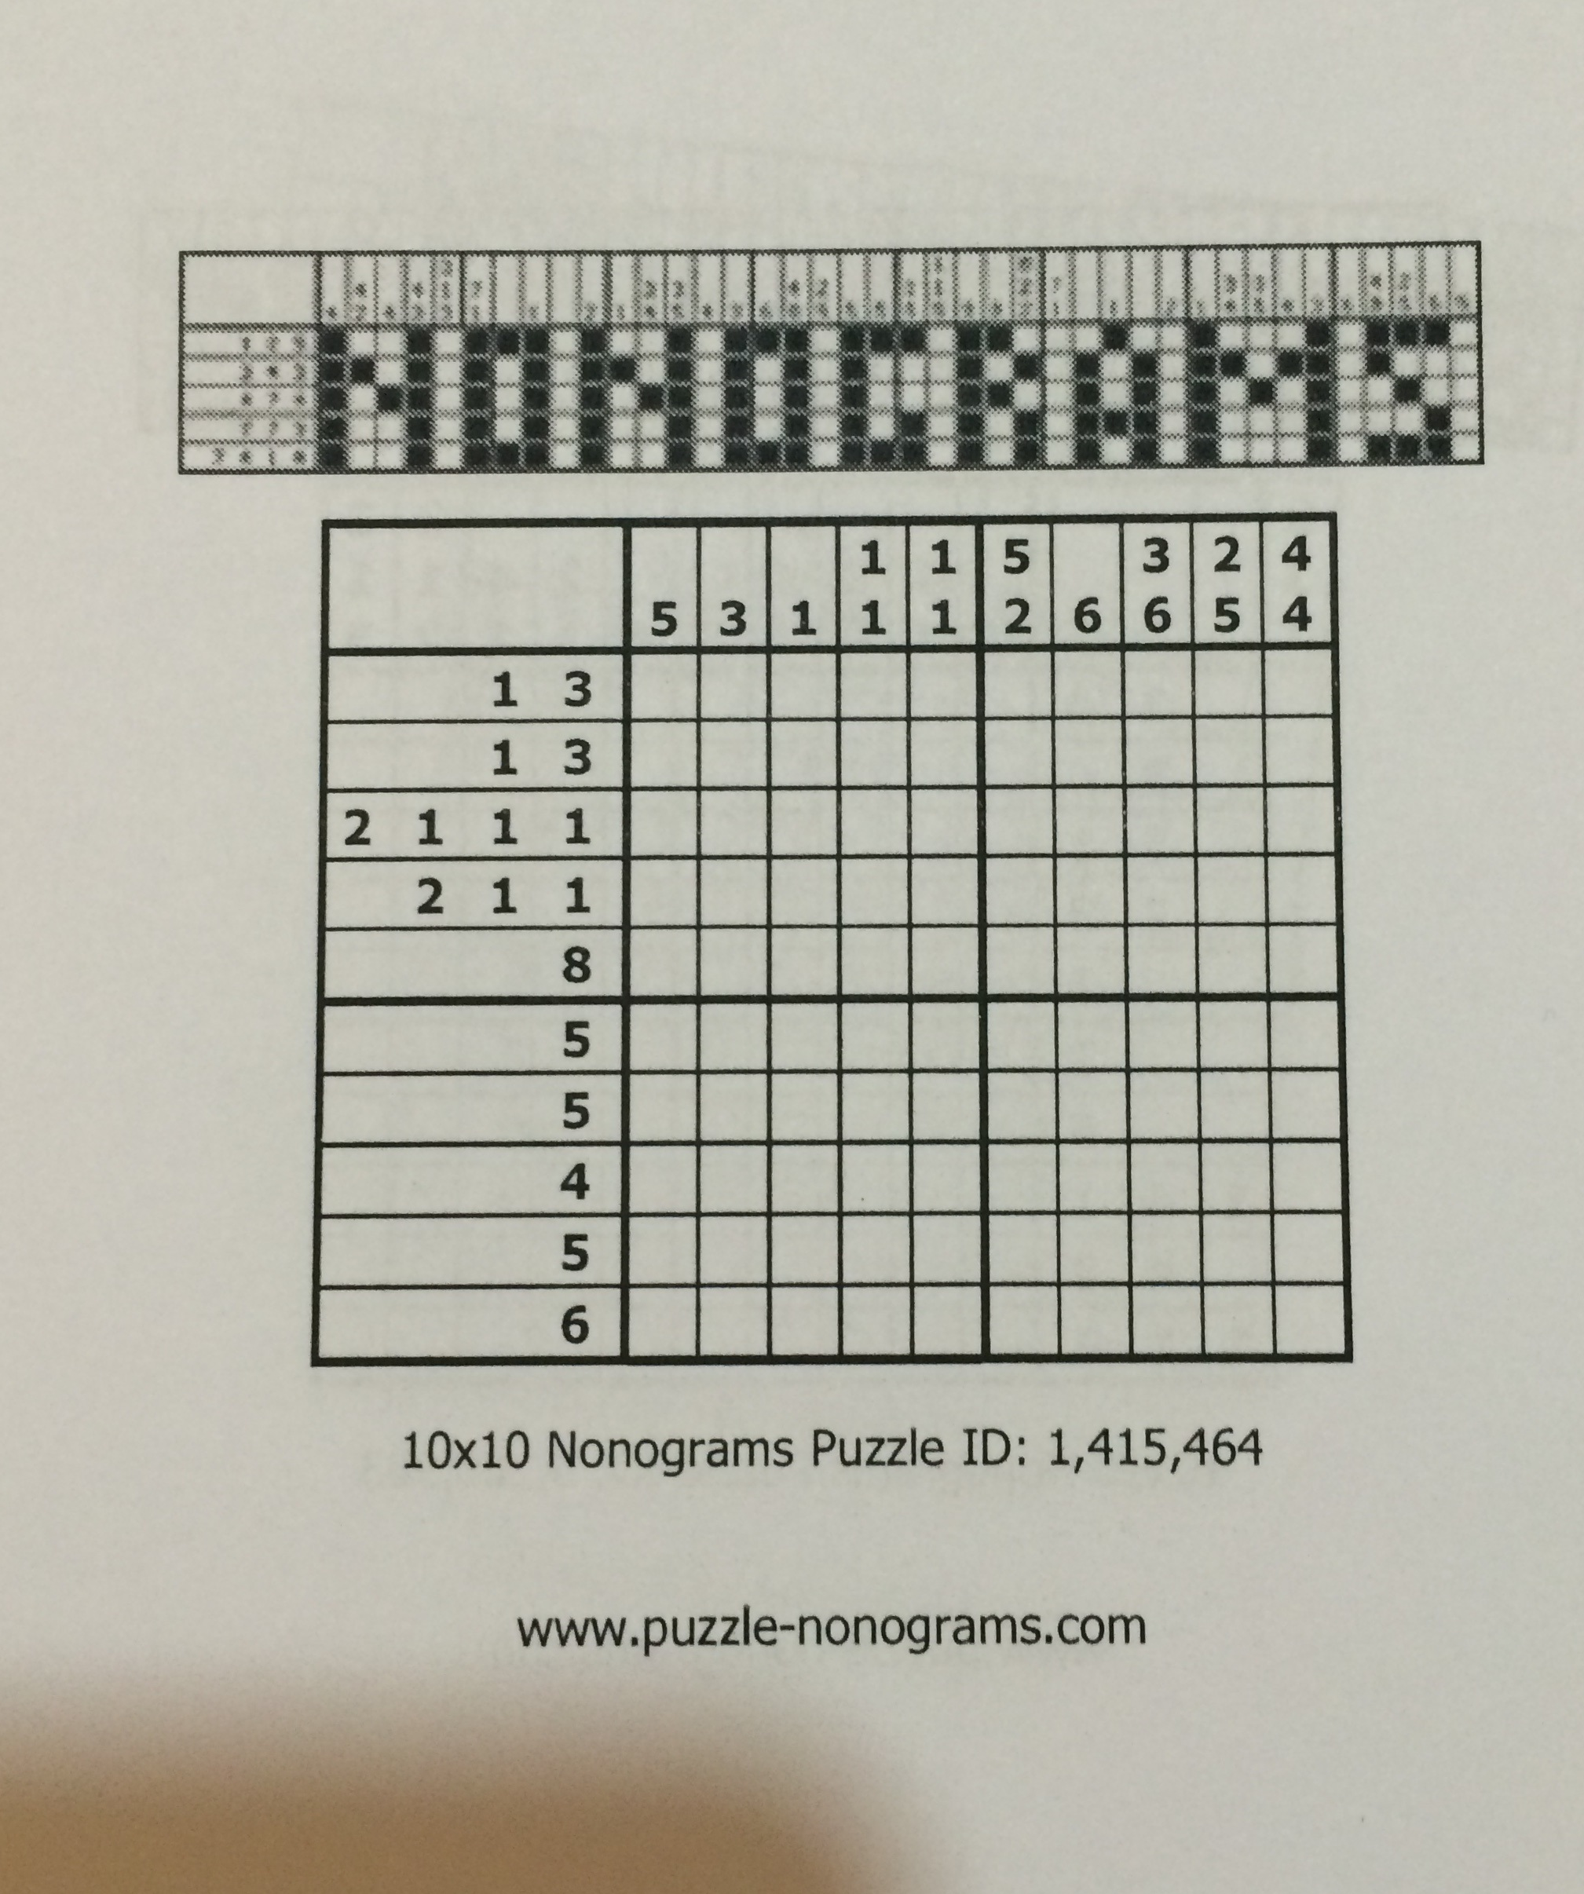
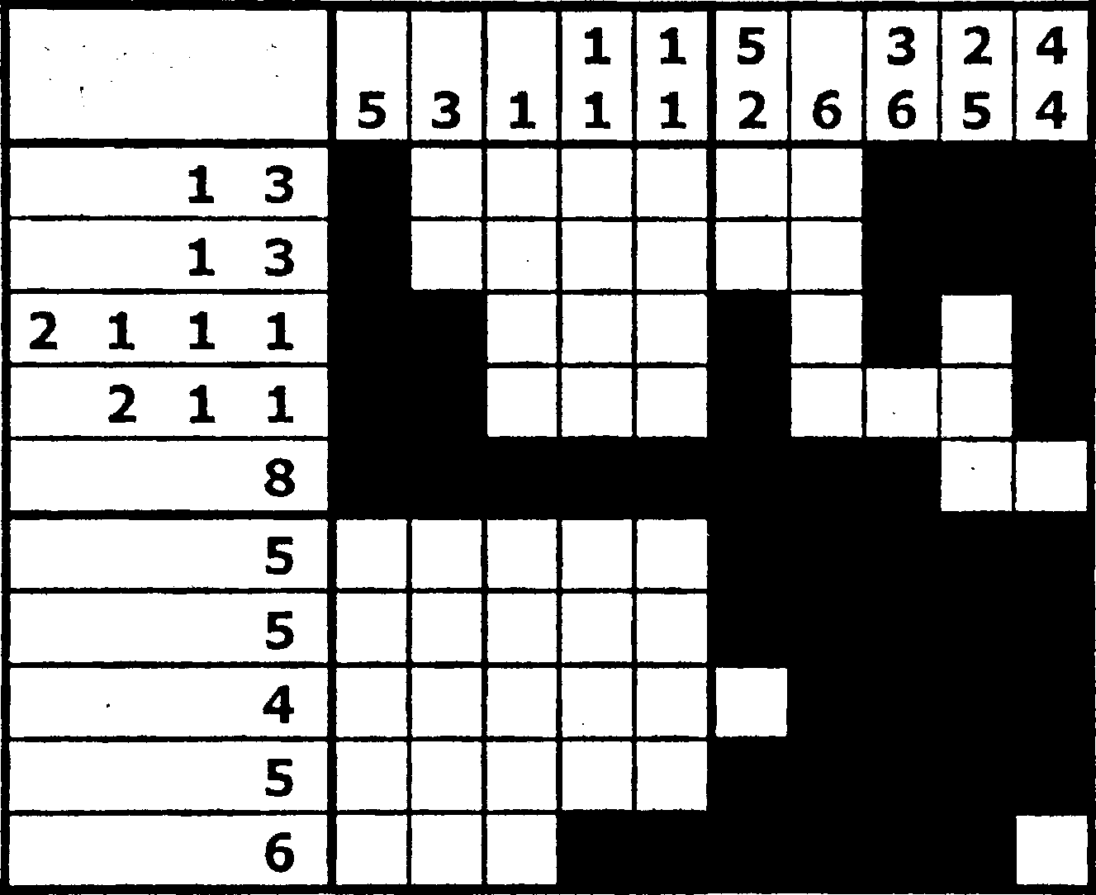
Prikazivanje rešenja

Slide 16
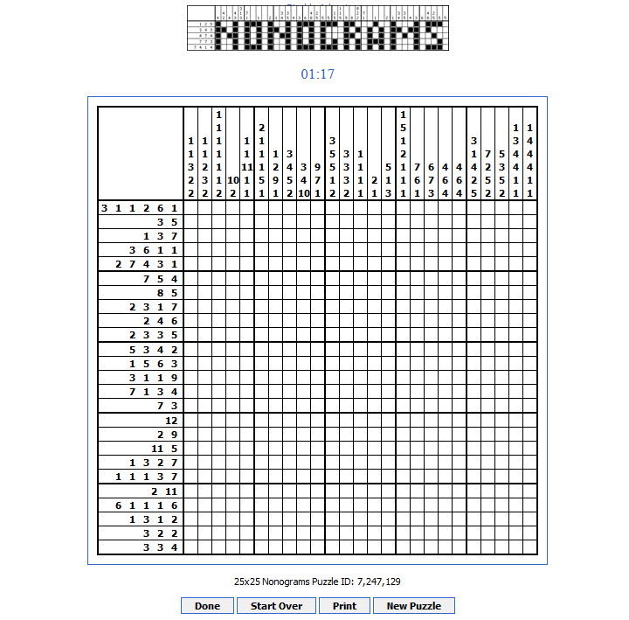
Verifikacija
http://www.puzzle-nonograms.com/
Do 20 x 20
Crno beli nonogrami

Slide 17
Rezultati i performanse
Samsung I8750
Huawei P7
IPhone 5S
Veličina | Rezultat
5x5 | 5/5 - 100%
10x10 | 5/5 - 100%
15x15 | 3/5 - 60%
20x20 | 1/5 - 20%
25x25 | 1/5 - 20%
Veličina | Rezultat
5x5 | 5/5 - 100%
10x10 | 5/5 - 100%
15x15 | 5/5 - 100%
20x20 | 5/5 - 100%
25x25 | 2/5 - 40%
Veličina | Rezultat
5x5 | 5/5 - 100%
10x10 | 5/5 - 100%
15x15 | 5/5 - 100%
20x20 | 5/5 - 100%
25x25 | 3/5 - 60%

Slide 18
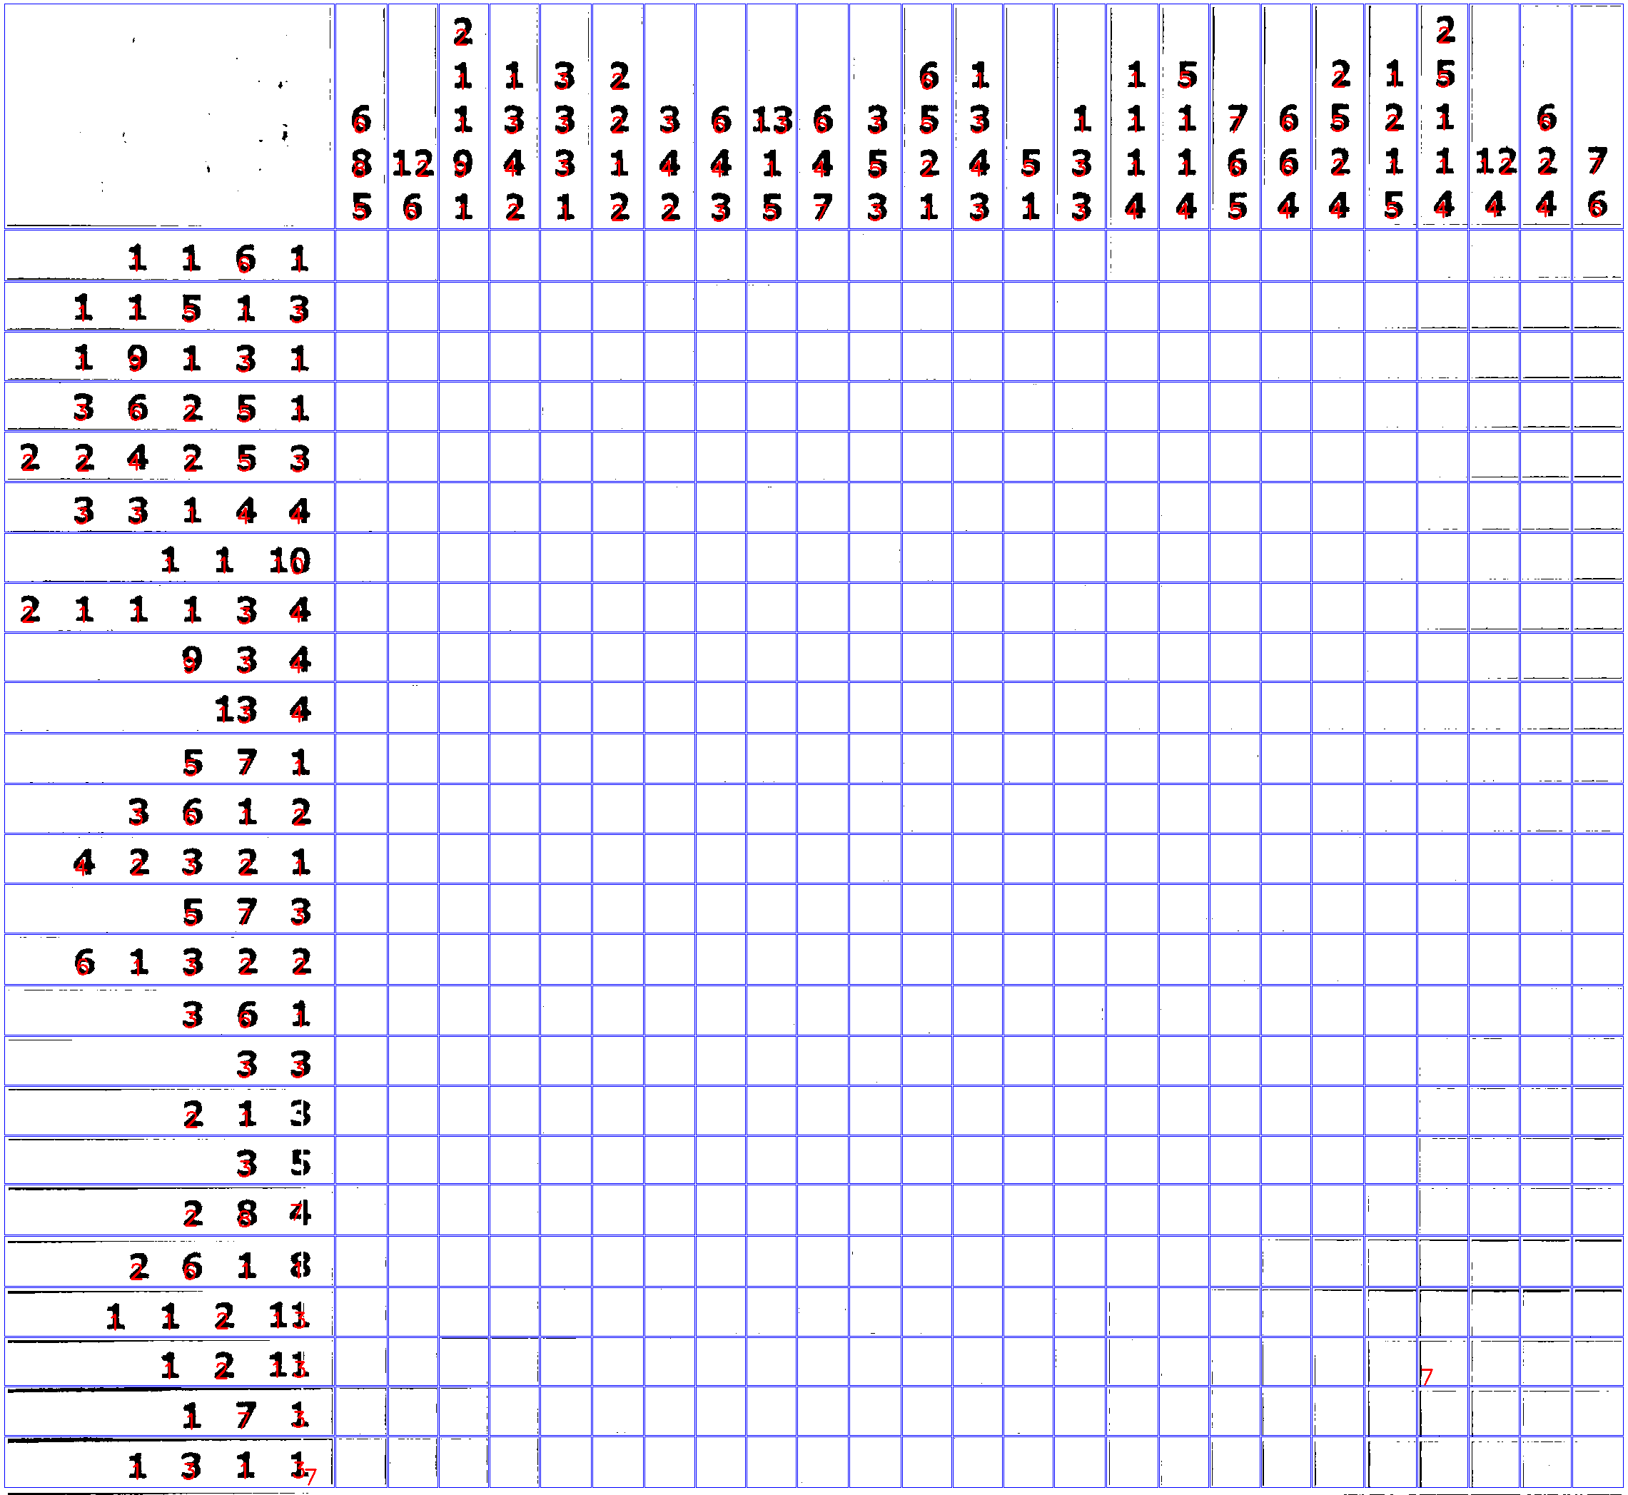
Neuspešni testovi

Slide 19
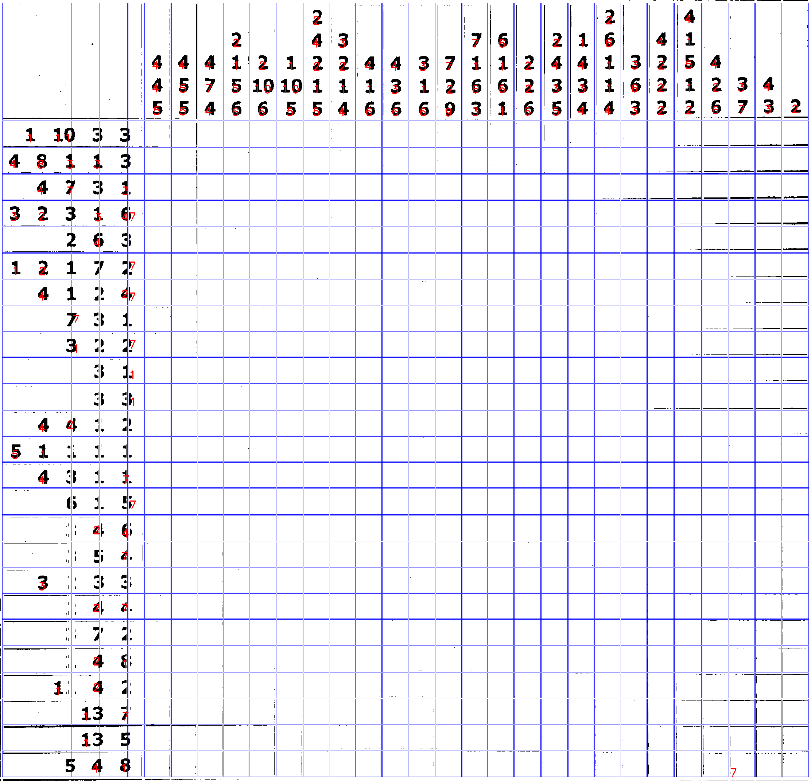
Neuspešni testivi

Slide 20
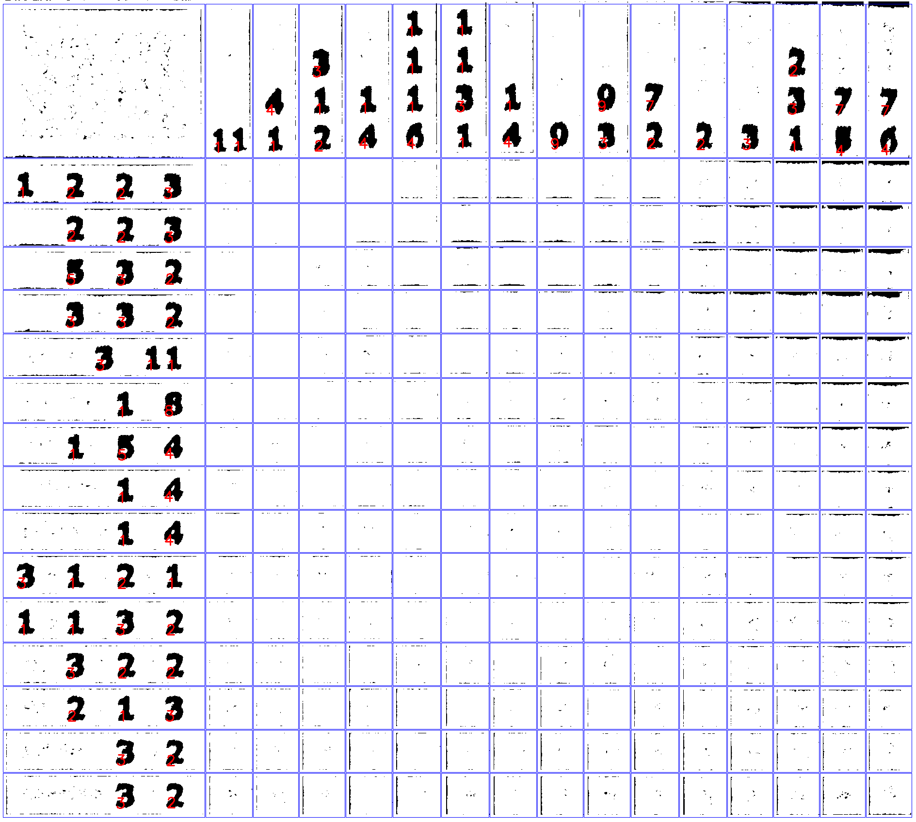
Neuspešni testovi

Slide 21
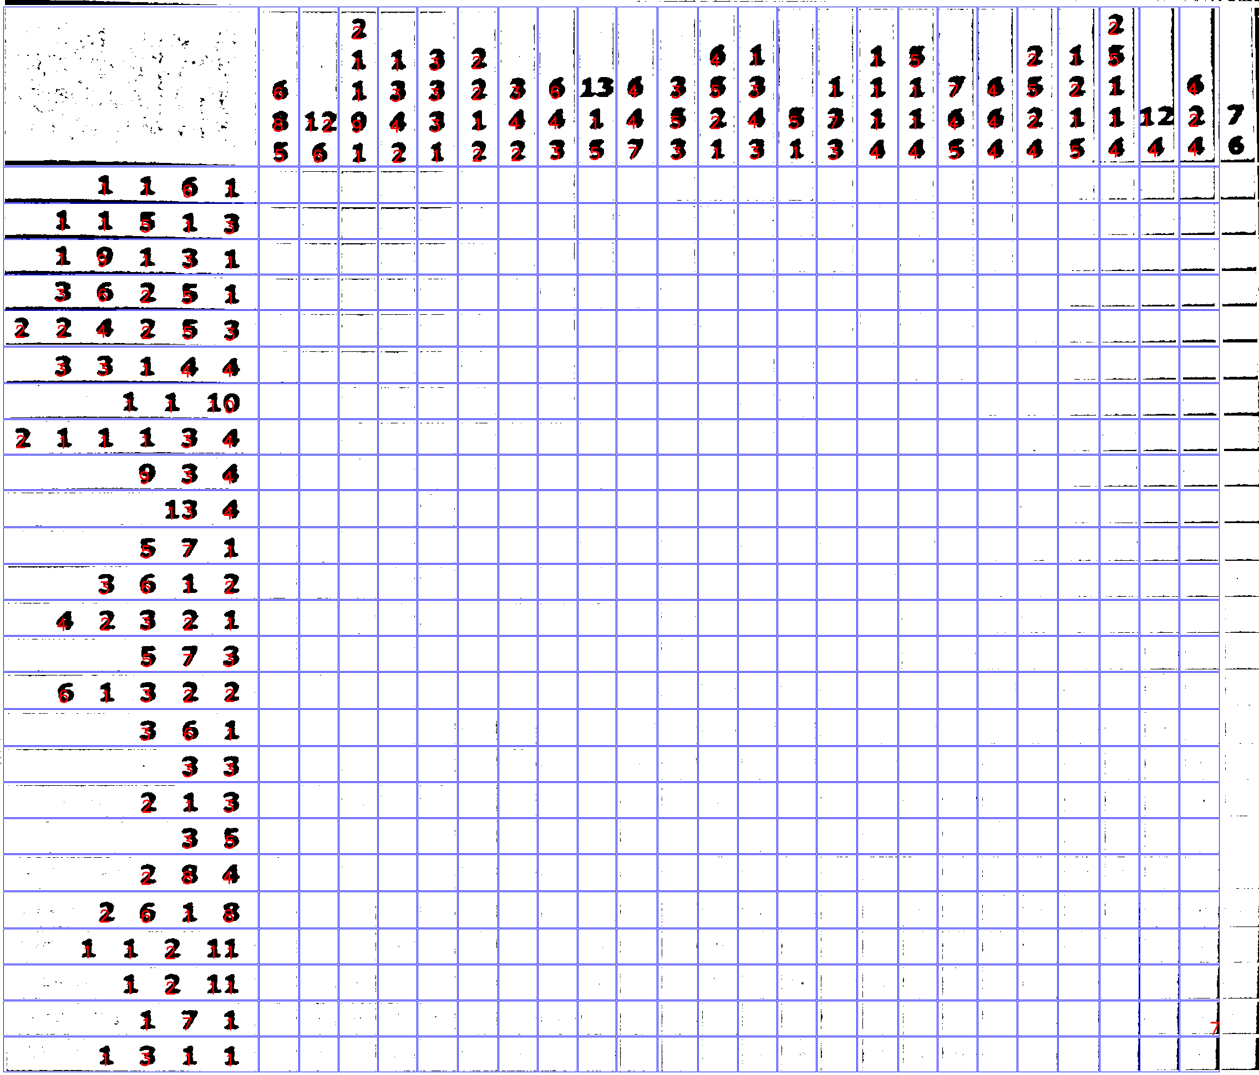
Neuspešni testovi

Slide 22
Hvala na pažnji
Srđan Milaković
srdjan.milakovic@outlook.com

